Slide 1
Machine Learning for Software Quality Assurance (“what has ML ever done for us?”)
Christian Kaestner

Slide 2
Methods and Qualities
Methods
Dynamic Analysis
Static Analysis
Metrics
Manual Testing
Unit Testing
System Testing
Instrumen-tation
Inspection
Data-Flow Analysis
Model checking
Formal Verification
Black Box
White box
Random
Qualities
Quality in use
Product quality
Process Quality
Effectiveness
Efficiency
Satisfaction
Freedom from risk / safety
Functional suitability
Performance efficiency
Compatibility
Usability
Dependability
Security
Maintainability
Portability
Suitability
Usability
Manageability
Reliability
Availability
Fault Tolerance
Recoverability
Completeness
Appropriateness
Correctness
Evolvability
Data Quality
Deep Dive:
Machine learning for QA methods
Crosscutting topics: Specifications, process integration (when, who, techn. debt, …), measurement

Slide 3
Machine Learning in a Nutshell
(labeled)
Data
Feature Extraction
ML
Model
Generalizes from data, finds patterns in data
Predict results for (unseen) data
classification, prediction, ranking, clustering, …
No guarantees/specifications

Slide 4
“We have data!”
Code
Issue reports
Version history (who changed what, when)
Static analysis reports
Test results
Runtime observations, logs
Task backlog

Slide 5
“We have Big Data!”
Huge codebases in Google, Facebook, Microsoft, …
Public activates of open source projects, including hobby projects and industrial systems (e.g., GitHub)
27M contributors, 80M projects, 1B traces, 10 years
Lots of data: Code, commits, commit messages, issues, bug-fixing patches, discussions, reviews, pull requests, teams, build logs, static analysis logs, coverage history, performance history
Lots of noise: Multitasking, interruptions, offline communication, project and team cultures, …

Slide 6
Opportunities for Helping Software Engineers
Automate or support manual tasks, direct human effort
bug triaging, bug repair, duplication detection, anomaly detection
Build better tools
better static analysis, better IDEs
Find new abstractions
pattern detection, performance models
Understand SE practices
defect prediction, tool effectiveness, interventions

Slide 7
Note
Previously, we investigated QA for systems with ML component
testing pipeline, including feature extraction
evaluating in practice
engineering tradeoffs beyond just accuracy
Developing new QA tools with ML techniques requires deeper focus on data analytics part
identifying relevant features and suitable learning technique

Slide 8
Prediction for QA

Slide 9
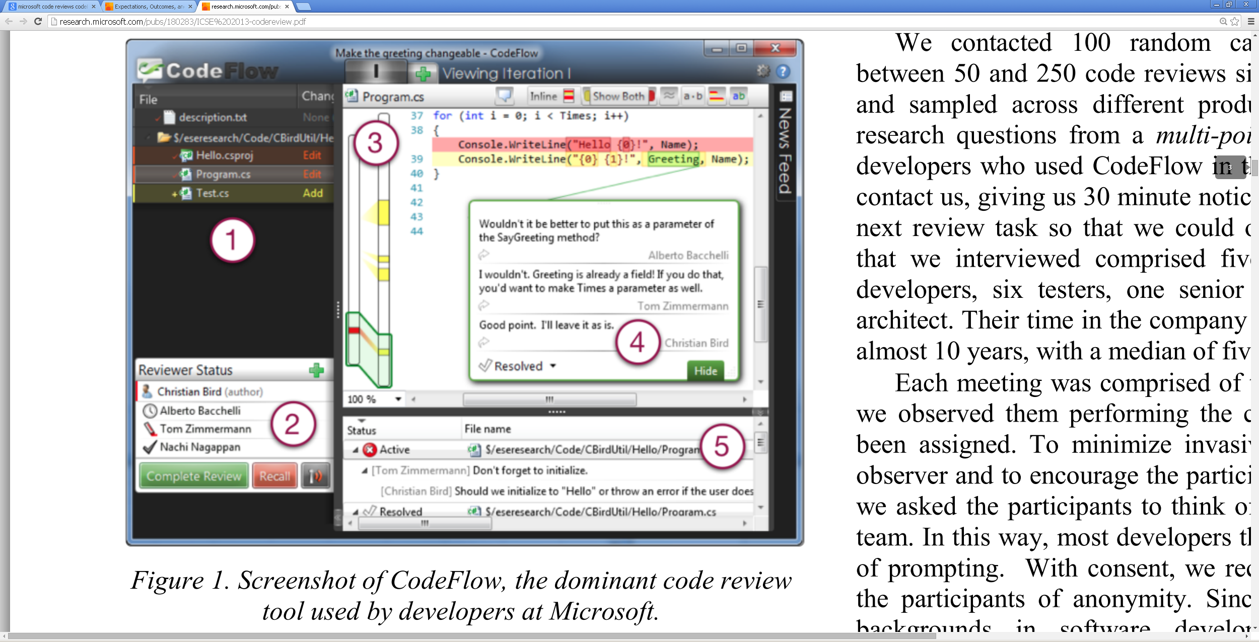
Case Study: Streamlining Code Review
Who should review
my pull request?
Data?
Features?
Learning approach?
Evaluation?
Degree of automation?

Slide 10
Example: Detecting Duplicate Pull Requests
L. Ren, S. Zhou, C. Kästner, and A. Wąsowski. Identifying Redundancies in Fork-based Development. In Proceedings of the 27th IEEE International Conference on Software Analysis, Evolution and Reengineering (SANER), 2019.

Slide 11

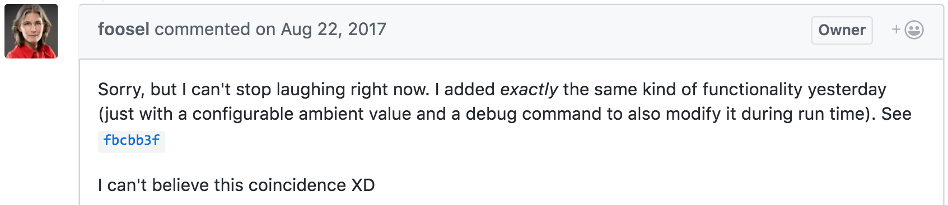


Example: Detecting Duplicate Pull Requests

Slide 12
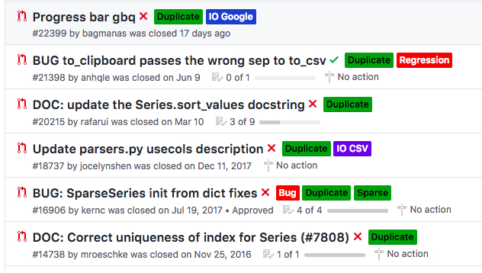
Example: Detecting Duplicate Pull Requests
23% of un-merged pull requests were rejected due to redundant development. [Gousios et al. 2014]

Slide 13

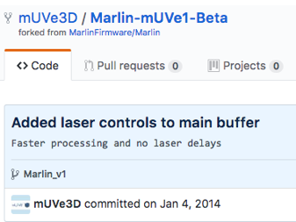
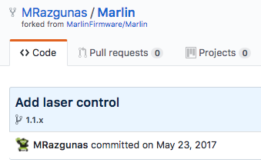

Redundant Feature Implementation
P3: “It does look like somebody did a very simple one-function. I think they should use our code, there is great reason to use it.” [Zhou et al. 2018]
P3

Slide 14
Cost / Waste
For maintainer:
- Maintenance effort
Before a duplicate PR is identified:
2.6 reviewers
5.2 review comments [Li et al. 2018]
For developers:
- De-motivate developers [Steinmacher et al. 2018]
14
Notes:
+collaboration, dup PR has values, rather than demotive, notice early, getting feedback from machine less embarrassing.

Slide 15
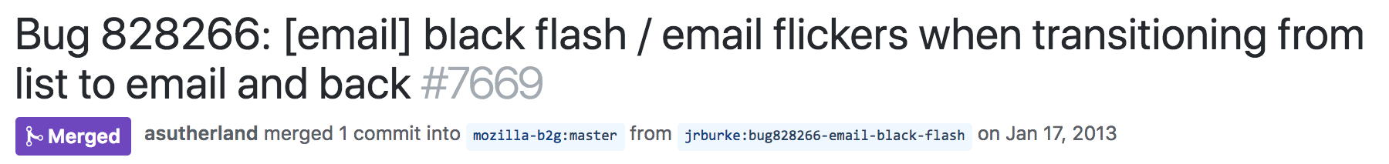
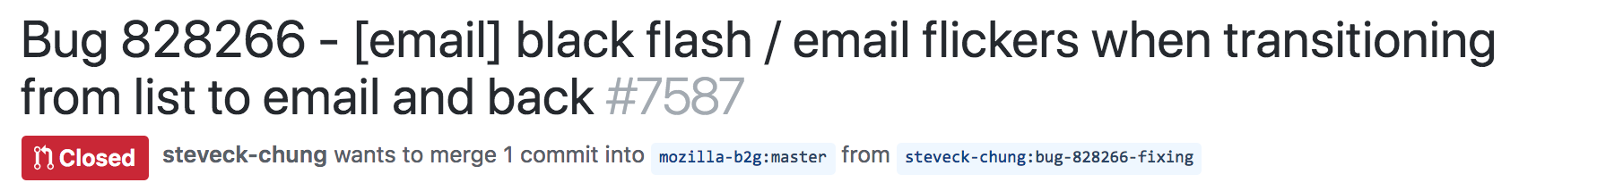
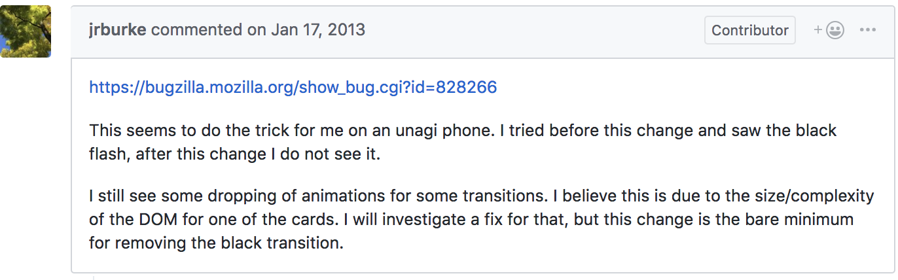
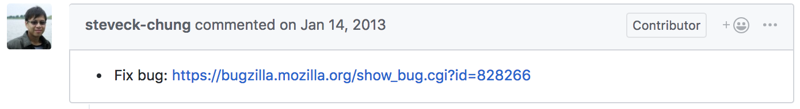
Similar title, different code (mozilla-b2g/gaia)

Slide 16
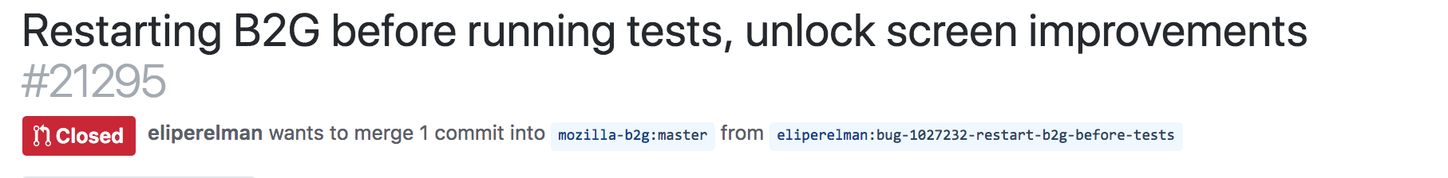
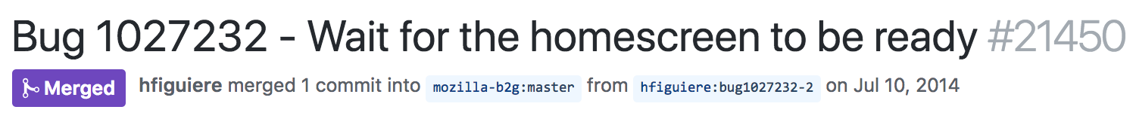
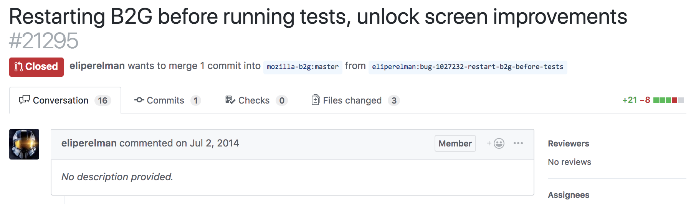
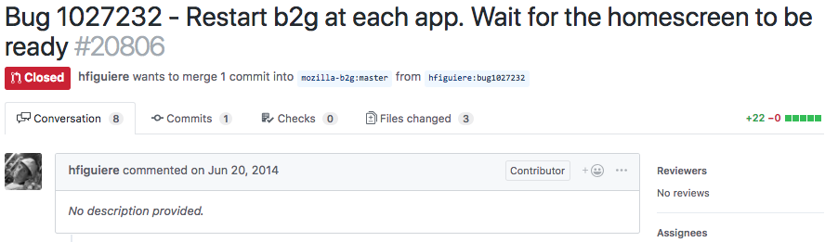
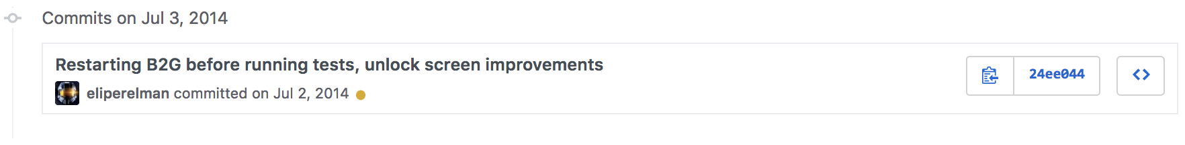
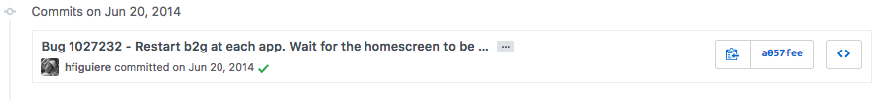
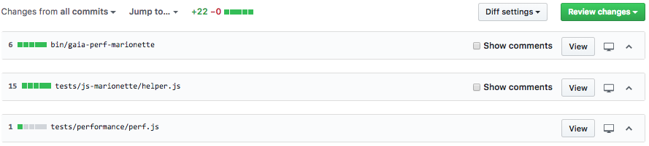
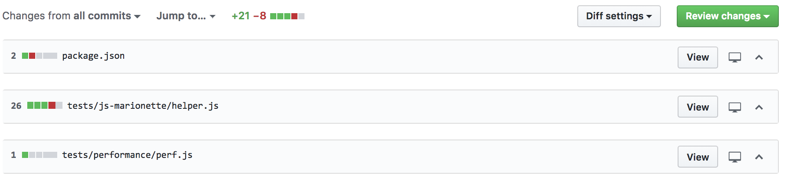
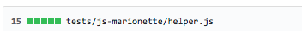
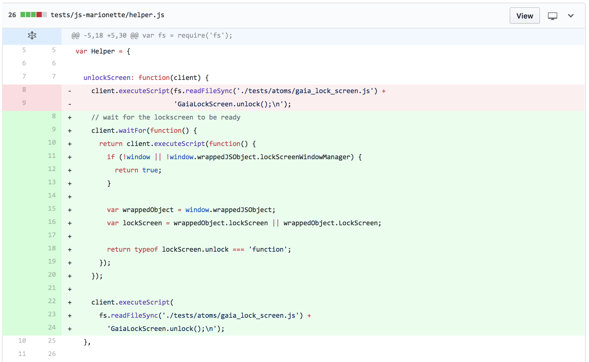
Different title, similar code (mozilla-b2g/gaia)

Slide 17
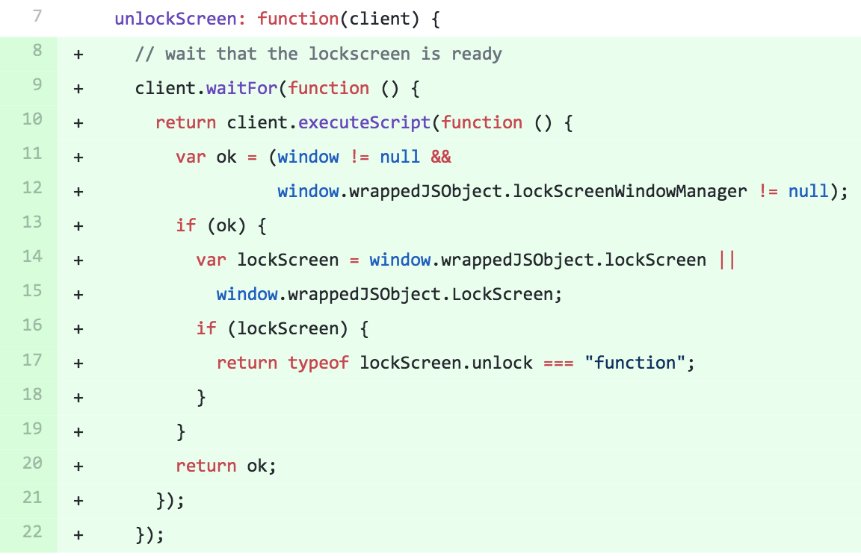
Different title, similar code (mozilla-b2g/gaia)

Slide 18
Engineering Process
Manually analyze duplicate PRs
Developing clues as indicators
Operationalization
ML predicting redundancies
Notes:
3rd --> operationalization

Slide 19
Engineering Process
Manually analyze duplicate PRs
Inspect mistakes and outliers
Developing clues as indicators
Operationalization
ML predicting redundancies
Notes:
3rd --> operationalization

Slide 20
Engineering Process
Identify sample of duplicate reports
Manually analyze duplicates, identify clues, interview/shadow developers (how humans would detect duplicates)
Operationalize clues -> feature development
Train, evaluate, and tune classifier
Inspect false positives and false negatives and outliers, revise feature extraction and cleaning strategies
Evaluate on fresh dataset or in practice

Slide 21
Example: Detecting Duplicate Pull Requests
Used features:
Similarity of title and description
Similarity of patch content (tokens)
Proximity/overlap of change locations
Reference to issue tracker
Other plausible features?

Slide 22
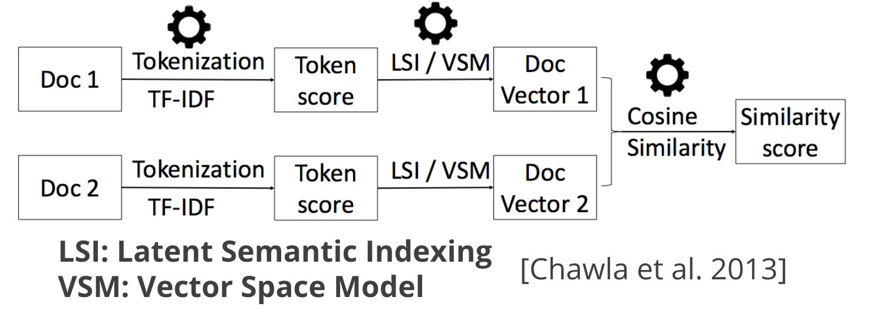
Operationalization

Slide 23
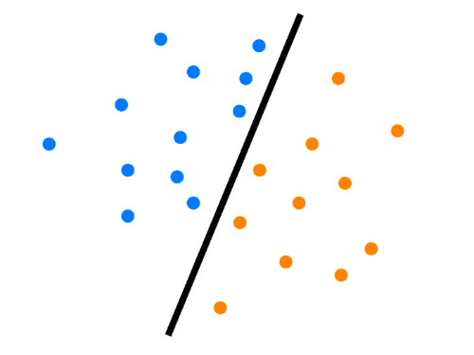





Predicting duplicate code changes using ML
List of Features
Positive
Model (AdaBoost)
Negative
Threshold
Similarity Score
Live data

Slide 24
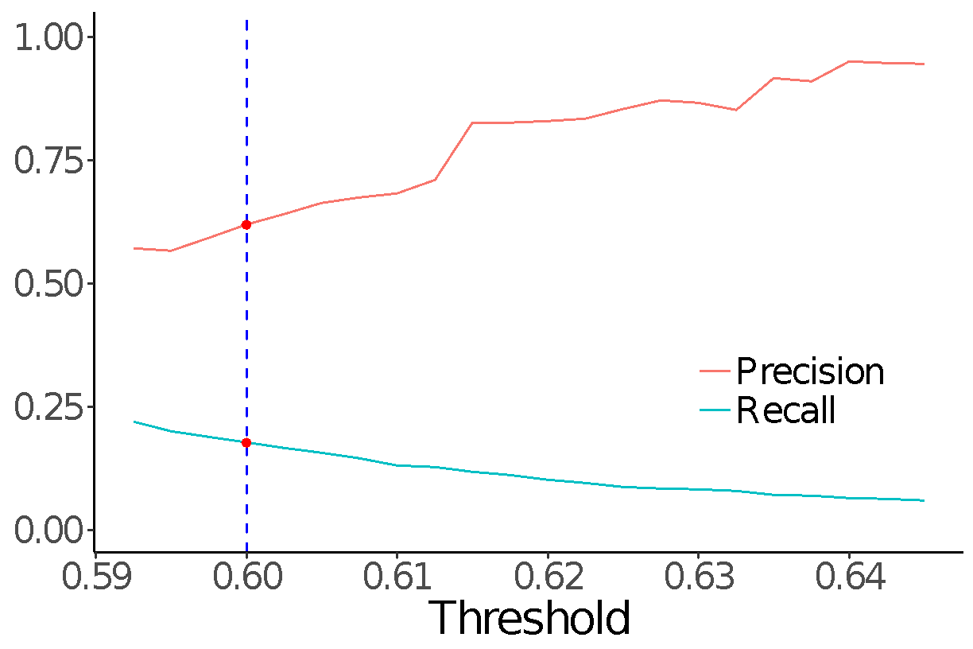
Evaluation
Randomly sample 400
PRs from each project
Precision 55-82%
Recall 10-25%
Notes:
explain we want a high recall
there is a room for improvement, but fairly decent result\
We argue that within a reasonable
threshold range of 0.5925–0.62, our approach achieved 57-
83% precision and 10-22% recall. After some experiments,
we pick a reasonable default threshold of 0.6175, where our
approach achieves 83% precision and 11% recall

Slide 25
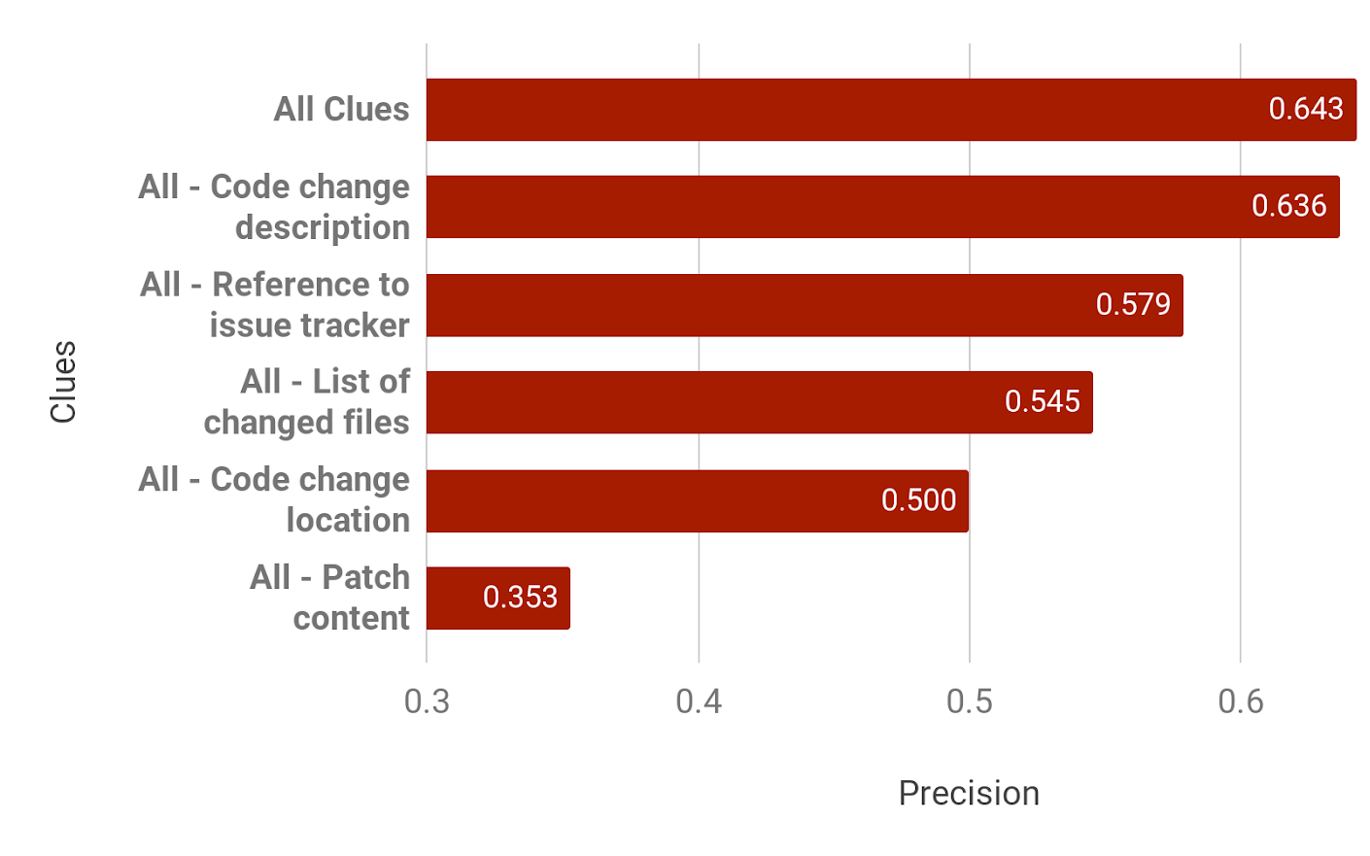
Sensitivity Analysis
Evaluation results
compared at same
recall (by adjusting
threshold)

Slide 26
Example: Performance Analysis/Debugging in Highly Configurable systems

Slide 27
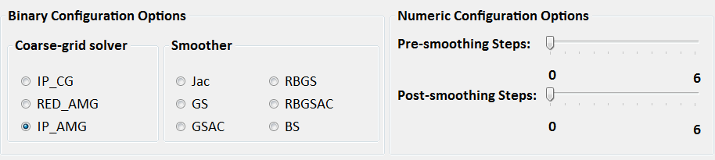
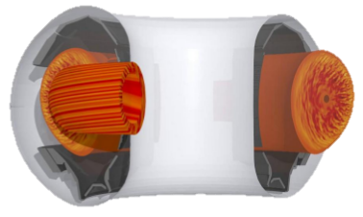
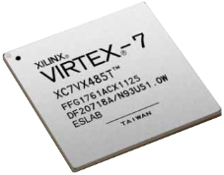
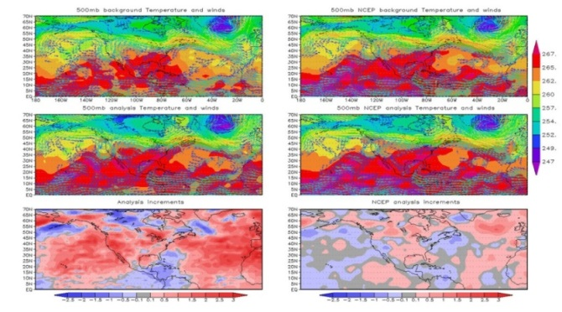
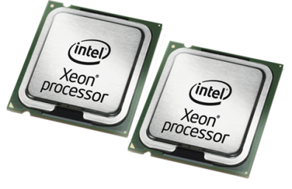
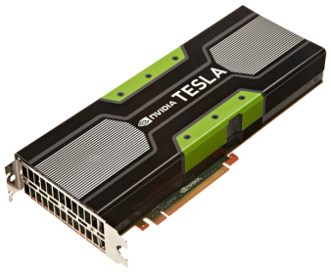

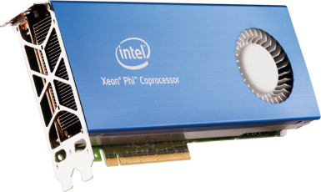
[Siegmund,FSE’15]

Slide 28
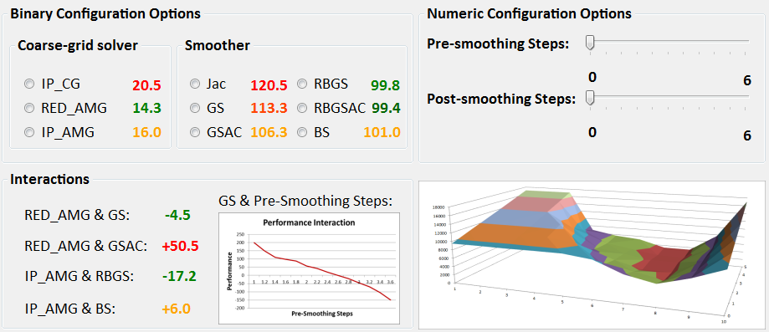
Debugging & Understanding
Prediction and optimization
14.3
+ 113.3
- 4.5
- 73.9
+ 171.7
= 219.9
[Siegmund,FSE’15]

Slide 29
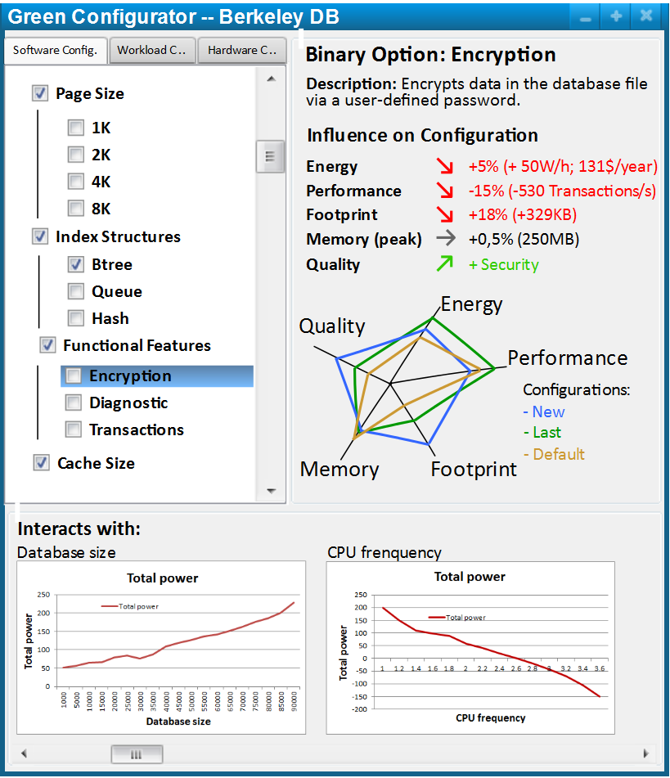

Slide 30




Exponential number!
Individual Options
Interactions
1
0
1
1
1
0
1
0
1
0
1
1
0
1
0
1
1
0
1
0
1
1
0
1
1
0
1
1
0
1
1
1
0
0
1
0
0
0
1
1
0
1
0
0
0
0
1
0
1
0
0
0
1
0
0
1
Perf.
10.3
55.8
21.9
60.1
59.3
29.3
45.6
Configurations
β₀
β₁
β₂
β₃
β₄
β₅
β₆
β₇
β₈
Error:
36.5
-24.3
15.3
-2.5
5.4
0.3
21%
30.4
-21.1
5.3
-2.4
3.5
0.2
26.1
-5.4
0.01
6%
p = β₀ + β₁*index + β₂*encr + β₃*compr + …
p = 36.5 – 24.3*index + 15.3*encr – 2.5*compr + …
[Siegmund,FSE’15]

Slide 31
Learning Strategy
Learn a simple, human-understandable performance model
Search to find the fasted configuration
Large configuration space, performance of configurations unknown until measured
Extrapolate from few measurements
Sampling strategy matters

Slide 32
Quick Pitch: AI for Software Engineering (17-649)

Slide 33

AI for Software Engineering (17-649)
Course to investigate state-of-the-art ways to apply advances in AI and machine learning to software engineering activities (requirements analysis and quality assurance)
The course is organized into three parts:
An introduction to natural language processing and symbolic AI, working with small datasets and focusing on knowledge extraction and representation;
Unsupervised and supervised machine learning for natural language processing; and
Deep learning applied to source code.
Instructor: Travis Breaux

Slide 34
Machine Learning for Quality Assurance
Real-world software quality assurance problems
Finding duplicate bug reports (over 38,000 Bugzilla reports)
Finding requirements interactions via traceability (NASA LANDSAT 8 Spacecraft)
Finding positive and negative application reviews (over 46,000 app reviews)
Finding bugs in code (over 50,000 C/C++ programs)
Machine learning techniques taught and covered
Vector space models for document clustering
Constituency and typed dependency parsing
Sentiment analysis using supervised machine learning
Deep learning using an RNN encoder-decoder

Slide 35
Anomaly Detection

Slide 36
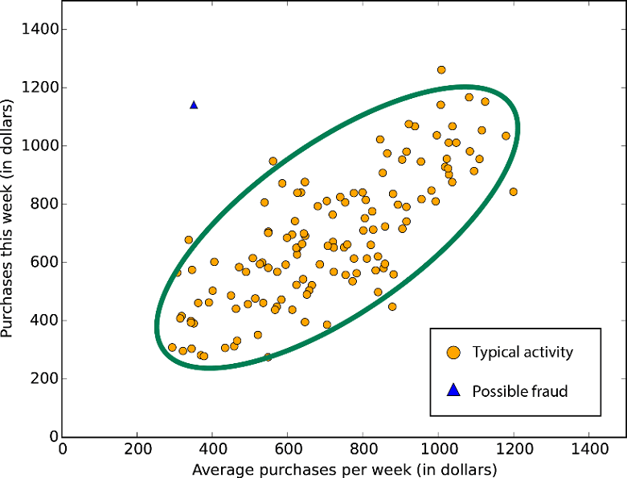

Slide 37
Anomaly Detection
Find outliers in dataset
point anomalies
contextual anomalies
collective anomalies
Anomalies can indicate bugs, attacks, new requirements, data drift, …
intrusion detection
fraud detection
medical/health anomaly detection
industrial damage detection
…
Chandola, Varun, Arindam Banerjee, and Vipin Kumar. "Anomaly detection: A survey." ACM computing surveys (CSUR) 41.3 (2009): 15.

Slide 38
Anomaly detection techniques
Supervised vs unsupervised learning
Various learning techniques
classification based
nearest neighbor
clustering based
statistical techniques
information-theoretic techniques
spectral techniques
Chandola, Varun, Arindam Banerjee, and Vipin Kumar. "Anomaly detection: A survey." ACM computing surveys (CSUR) 41.3 (2009): 15.

Slide 39
Anomaly Detection in QA?

Slide 40
Example: Anomaly Detection for Code Reviews
Focus code review on unusual changes
Features?
R. Goyal, G. Ferreira, C. Kästner, and J. Herbsleb. Identifying Unusual Commits on GitHub. Journal of Software: Evolution and Process (JSEP), 30(1):, January 2018.

Slide 41
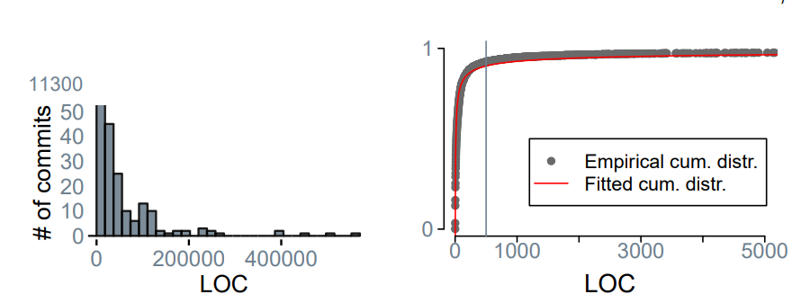
Statistical Models of Typical Changes

Slide 42
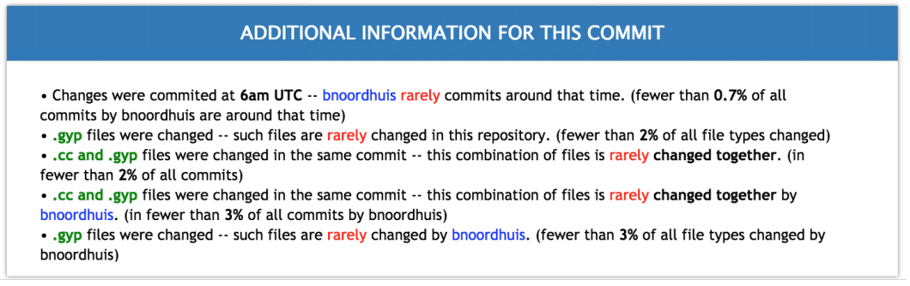
Explaining Outliers

Slide 43
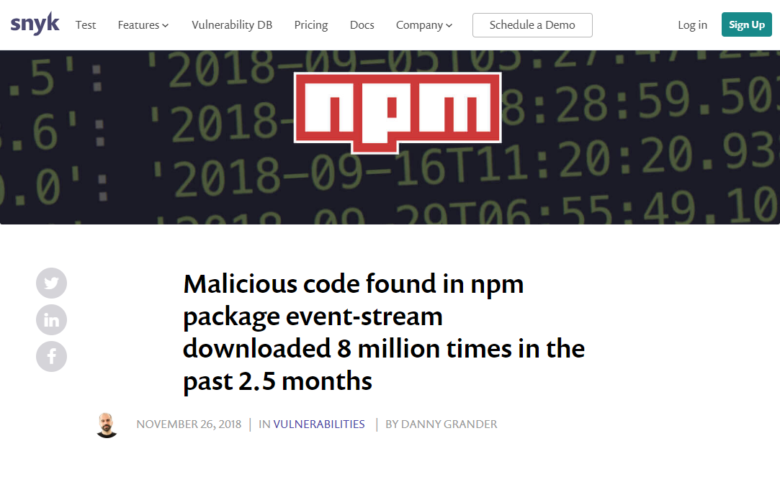
Example: Anomaly Detection to Detect Malicious Package Updates
K. Garrett, G. Ferreira, C. Kästner, J. Sunshine, and L. Jia. Detecting Suspicious Package Updates. In ICSE-NIER, 2019.

Slide 44
Example: Anomaly Detection to Detect Malicious Package Updates
Inspect (do not auto-install) updates with suspicious changes
Features?

Slide 45
Example: Anomaly Detection to Detect Malicious Package Updates
Inspect (do not auto-install) updates with suspicious changes
Features?
Change size
Access to APIs (network, eval, …)
Obfuscated/encrypted payload (entropy)
Install hooks
…
Clustering technique used

Slide 46
Anomaly Detection for Android Malware Classifier
Features?

Slide 47
Data Analytics of Software Engineering Activities

Slide 48
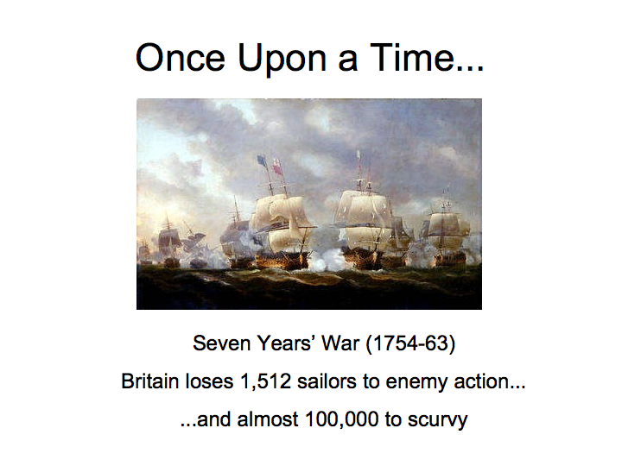

Slide 49
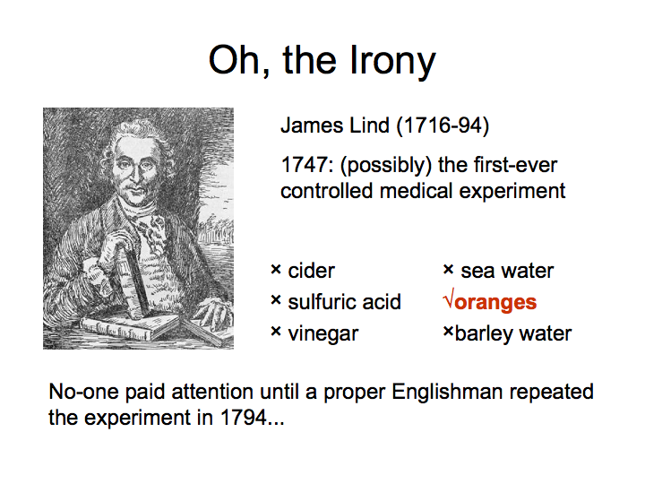

Slide 50
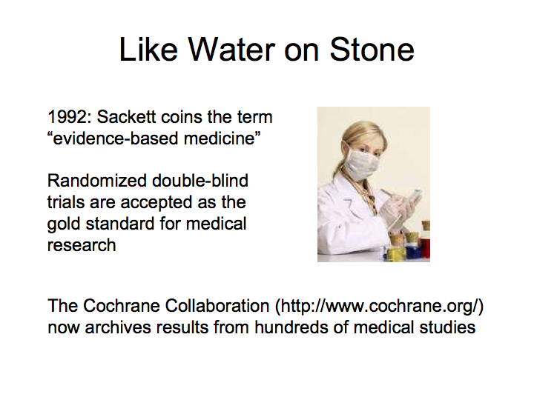

Slide 51
What about Software Engineering and QA?

Slide 52
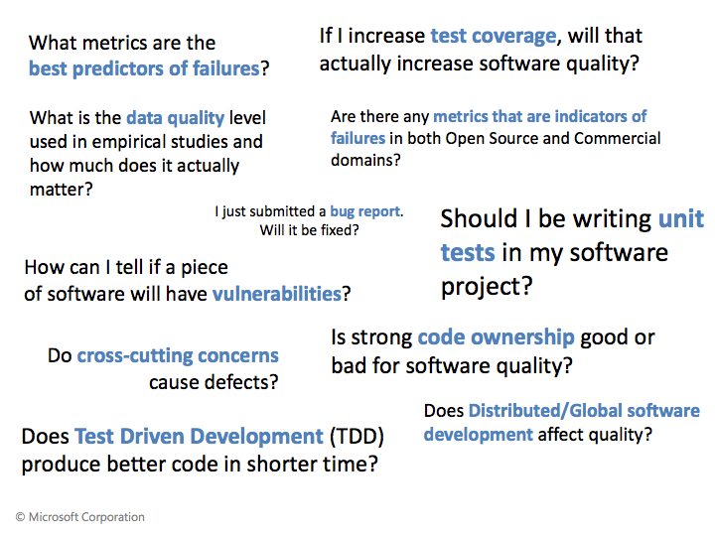

Slide 53
How would you approach these questions with data?
Where to focus testing effort?
Is our review practice effective?
Is the expensive static analysis tool paying off?
Should we invest in security training?

Slide 54
Evaluate Effectiveness of an Intervention
Controlled experiments
Compare group with intervention against control group without,
Randomized controlled trials, AB testing, …
Ideally blinded
Natural experiments, Quasi experiments
Compare similar groups that naturally only differ in the intervention
No randomized assignment of treatment condition
Time series analyses
Compare measures before and after intervention, preferably across groups with the intervention at different times

Slide 55
Large Datasets now accessible
Huge codebases in Google, Facebook, Microsoft, …
Public activates of open source projects, including hobby projects and industrial systems (e.g., GitHub
27M contributors, 80M projects, 1B traces, 10 years
Lots of data: Code, commits, commit messages, issues, bug-fixing patches, discussions, reviews, pull requests, teams, build logs, static analysis logs, coverage history, performance history
Lots of noise: Multitasking, interruptions, offline communication, project and team cultures, …

Slide 56
Data Science on Big Code
Answer large, more general questions:
What team size is most productive or produces highest quality?
Is multitasking causing buggy code?
Do co-located teams perform better?
Does code review improve quality?
Find trends in big noisy data sets using advanced statistics
Find even small relationships with natural experiments: Compare similar projects that differ only in one aspect (given the size, there will be many pairs for most questions)

Slide 57
Example: Defect Prediction
Which modules are most defect prone? Where to focus our QA efforts?
Features?
Theory?

Slide 58
Features for Defect Prediction
Various software metrics (size, cyclomatic complexity, maintainability index, coupling, comment density, …)
Development history (churn, hotness, logical cohesion)
Network metrics, cross-module/cross-project dependencies (e.g., centrality of module)
Characteristics and network of developers (e.g., email communication, location and team structure)
Anti-patterns, static analysis

Slide 59
Prediction vs Understanding
Black-box predictors may more accurately identify defect-prone modules
Theory-driven exploration of factors may reveal root causes and suggest interventions:
“Geographically distributed teams produce code whose quality (defect occurrence) is just as good as teams that are not geographically distributed” - No statistical difference detected at Microsoft
“Defect probability increases if teams consist of members with large organizational distance” - Key predictor for defect density found at Microsoft

Slide 60
Example: Badges
A. Trockman, S. Zhou, C. Kästner, and B. Vasilescu. Adding Sparkle to Social Coding: An Empirical Study of Repository Badges in the npm Ecosystem. In Proceedings of the 40th International Conference on Software Engineering (ICSE), New York, NY: ACM Press, May 2018.

Slide 61
Automated Program Repair

Slide 62




Problem: source-level defect repair
Automatic repair magic
bug-fixing patch
Notes:
This is the fundamental problem in source-level defect repair. We have a program that is doing many things correctly but at least one thing incorrectly. In the wild this may be validated in a number of ways. In research practice we typically use test cases to encode desired behavior, so a bug to be fixed corresponds to a test that is failing. In software engineering practice, my goal was to produce a small set of changes in the form of a patch that, when applied to the input program, resulted in a very similar program that did all of the same things as before, but produced the correct output for the failing test case. The goal in automatic program repair research is to develop methods that can produce those types of patches automatically, freeing developers from the burden of three days of Ukrainian unicode standards.

Slide 63



Spectrum-based fault localization automatically ranks potentially buggy program pieces based on test case behavior.
Input:
1
2
3
4
printf transformer
5
6
7
Likely faulty. probability
Maybe faulty. probability
Not faulty.
8
9
10
11
12
Notes:
and I did that because if you run a program with a bunch of printfs on its test cases and look at the output, just seeing what was executed by which inputs tells you something about which parts of the program is most suspicious. This is effectively what spectrum based fault localization approaches are doing, but automatically and with better math. They run the program on its test cases, look at the output, and then provide ranks or scores to different pieces of the program based on how likely they are to be constributing to the bug.

Slide 64

GenProg: automatic program repair with evolutionary computation.
Biased, random search for a AST-level edits to a program that fixes a given bug without breaking any previously-passing tests.
Notes:
The first technique is called GenProg. It uses a biased, random search for AST-level edits to a program to fix a bug. There are a trivially infinite number of patches that can fix any particular bug, so the challenge here is to manage and traverse the search space in a tractable way such that we can find patches in a reasonable amount of time. Random search can be a good way to look for something under certain circumstances, like one where your search landscape is large and unknown but you can make some reasonable domain assumptions about what it looks like to traverse it feasibly.

Slide 65

Genetic programming: the application of evolutionary or genetic algorithms to program source code.
Notes:
There are a number of options in terms of random search. The technique GenProg uses is based on genetic programming, which is the application of evolutionary algorithms to program source code, where genetic algorithms are those based on biological principles of evolution. It’s an imperfect but reasonable domain for genetic programming because we’re manipulating programs as trees, and there’s a well-understood body of knowledge on how to do that. So the problem fits the solution assumptions.

Slide 66


INPUT
EVALUATE FITNESS
DISCARD
ACCEPT
MUTATE
OUTPUT
Notes:
Here’s a diagram to show you how this works. Evolutionary computation is a population based approach---it generates and then manipulates a set of candidate solutions to the problem at hand. So we start with a program and its test cases, and create a large set of possible solutions. Each solution is evaluated for its suitabiliy or fitness, which is how close to the goal it’s predicted to be.

Slide 67
Many Advances
Repair patterns, mined from human bug fixes
Synthesis of fixes for specific classes of problems
Measuring and managing overfitting
Large datasets of real bugs
Automation in practice, initial industry adoption
…

Slide 68
Summary
Many QA tasks can be supported with intelligent automation
Many different tools and applications: prediction, classification, ranking, anomaly detection, …
all phases and QA approaches, including testing, performance analysis, code review, static analysis, and process improvement
Creativity in feature engineering needed: data analytics and science
Next Semester: AI for Software Engineering (17-649)

Slide 69
AI for Software Engineering (17-649)
Course to investigate state-of-the-art ways to apply advances in AI and machine learning to software engineering activities (requirements analysis and quality assurance)
The course is organized into three parts:
An introduction to natural language processing and symbolic AI, working with small datasets and focusing on knowledge extraction and representation;
Unsupervised and supervised machine learning for natural language processing; and
Deep learning applied to source code.
Instructor: Travis Breaux

